Slide 1
Transmission Media
CHAPTER 4 – William Stallings

Slide 2
TYPES OF TRANSMISSION MEDIA
Guided transmission media
Unguided (Wireless)transmission media

Slide 3
Guided media (physical path)
→Twisted pair, coaxial cable, and optical fiber.
→Electromagnetic waves are guided over the solid medium.
Unguided (antenna for transmitting)
Air, vacuum, or water.
→Techniques commonly used for information communications include broadcast radio, terrestrial microwave, and satellite.

Slide 4
What are the key concerns for the design of data transmission systems?
High data rates over long distance
Bandwidth
Transmission impairments
Interference

Slide 5
GUIDED TRANSMISSION MEDIA
Twisted Pair
Coaxial cable
Optical Fiber

Slide 6

TWISTED PAIR
A twisted pair consists of two insulated copper wires arranged in a regular spiral pattern.
Twisting tends to decrease cross talk.
Neighbouring pairs will have different twist length to reduce cross talk.
Twist length: 5 to 15cm
—Separately insulated
—Twisted together
—Often "bundled" into cables
—Usually installed in building during construction

Slide 7
TWISTED PAIR - TRANSMISSION CHARACTERISTICS
Analog
Needs amplifiers every 5km to 6km
Digital
Needs a repeater every 2-3km
Limited in distance
Limited in bandwidth (1MHz)
Limited in data rate
For long distance- limited data rate (100Mbps- 1 Gbps)
For short distance data rate(10Gbps)
Less expensive

Slide 8

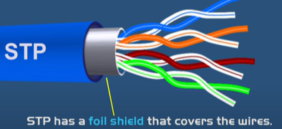
VARIETIES OF TWISTED PAIRS
Unshielded Twisted Pair (UTP)
Ordinary telephone wire
Cheapest
Easiest to install
Suffers from external EM interference from nearby twisted pair. (No electromagnetic shielding)
Commonly used for local area networks.
Shielded Twisted Pair (STP)
Metal braid or sheathing that reduces interference
Better performance at higher data rates.
More expensive
Harder to handle (thick, heavy)

Slide 9
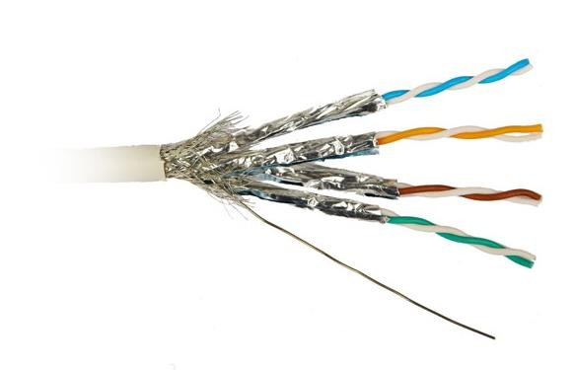
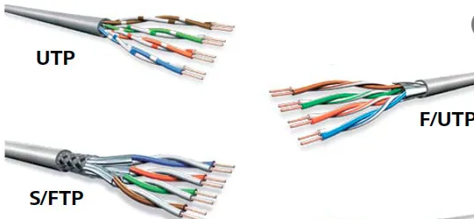
CONT…

Slide 10
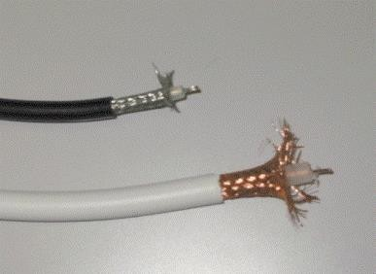
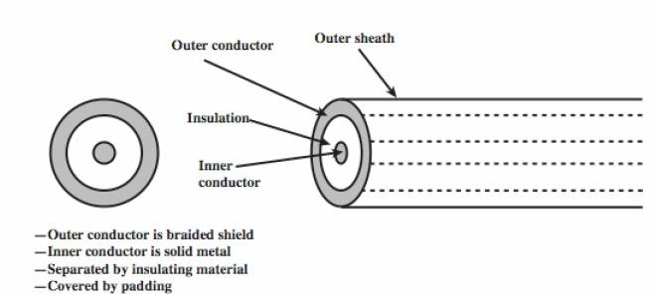
COAXIAL CABLE

Slide 11
Consists of two conductors but is constructed differently to TP to permit it to operate over a wider range of frequencies.
It consists of a hollow outer cylindrical conductor that surrounds a single inner wire conductor.
The inner conductor is held in place by either regularly spaced insulating rings or a solid dielectric material.
The outer conductor is covered with a jacket or shield.
A single coaxial cable has a diameter of from 1 to 2.5 cm.

Slide 12
COAXIAL CABLE - TRANSMISSION CHARACTERISTICS
It can be used effectively at higher frequencies and data rates.
Less susceptible to interference and crosstalk when compared to TP
Performance limited by attenuation & noise
🞤 Analog signals
amplifiers every few km
🞤 Digital signals
repeater every 1 km

Slide 13
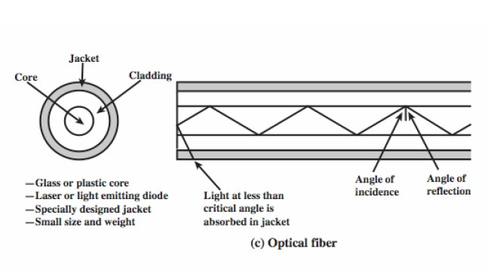
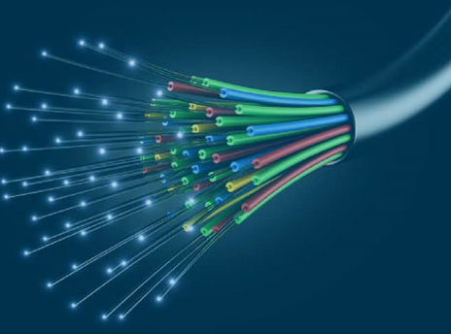
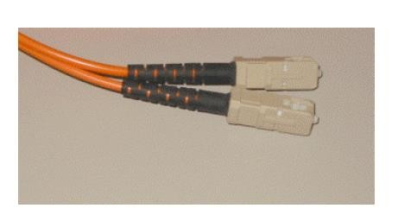
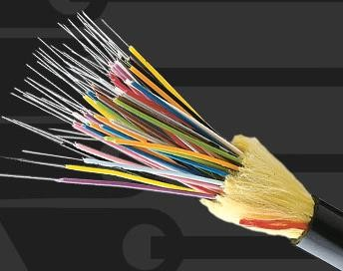
OPTICAL FIBER

Slide 14
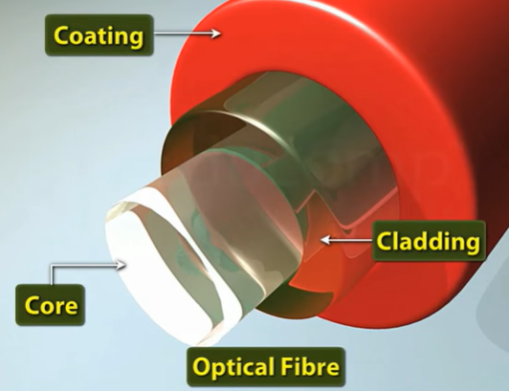
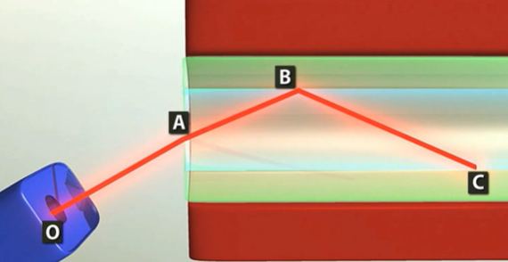
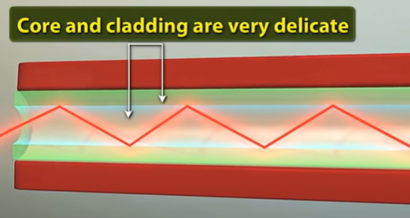

Slide 15
An optical fiber cable has a cylindrical shape and consists of three concentric sections: the core, the cladding, and the jacket
The core is the innermost section and consists of one or more very thin strands, or fibers, made of glass or plastic.
Each fiber is surrounded by its own cladding, a glass or plastic coating that has optical properties different from those of the core .
The interface between the core and cladding acts as a reflector to confine light that would otherwise escape the core. The outermost layer, surrounding one or a bundle of cladded fibers, is the jacket.
The jacket is composed of plastic and other material layered to protect against moisture, crushing, and other environmental dangers.

Slide 16
OPTICAL FIBER - BENEFITS
Bandwidth of 370THz
Greater capacity
Data rates of hundreds of Gbps
Smaller size & weight
Lower attenuation
Greater repeater spacing: 10s of km.
Electromagnetic isolation: Not affected by external electromagnetic interference

Slide 17
OPTICAL FIBER - TRANSMISSION CHARACTERISTICS
Optical fiber transmits a signal-encoded beam of light by means of total internal reflection.
Total internal reflection can occur in any transparent medium that has a higher index of refraction than the surrounding medium.
Act as wave guide for 1014 to 1015 Hz
Can use several different light sources
Light Emitting Diode (LED)
cheaper, wider operating temp range, lasts longer
Injection Laser Diode (ILD)
more efficient, has greater data rate

Slide 18
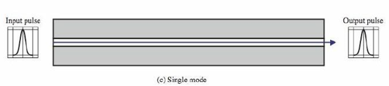
When the fiber core radius is reduced, fewer angles will reflect.
By reducing the radius of the core to the order of a wavelength, only a single angle or mode can pass.
Used for long-distance applications, including telephone and cable television.

Slide 19
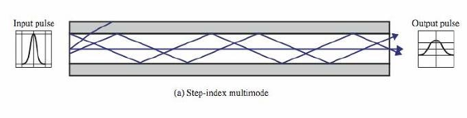
OPTICAL FIBER TRANSMISSION MODES
Light from a source enters the cylindrical glass or plastic core.
Rays at shallow angles are reflected and propagated along the fiber; other rays are absorbed by the surrounding material
Multiple propagation path exists each with a different path length and hence time to traverse the fiber.
Signals will spread out and limits the rate at which it is received.

Slide 20
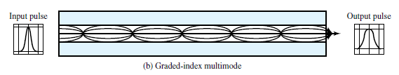
The higher refractive index (discussed subsequently) at the center makes the light rays moving down the axis advance more slowly than those near the cladding.
Rather than zig-zagging off the cladding, light in the core curves helically because of the graded index, reducing its travel distance.
The shortened path and higher speed allows light at the periphery to arrive at a receiver at about the same time as the straight rays in the core axis.

Slide 21
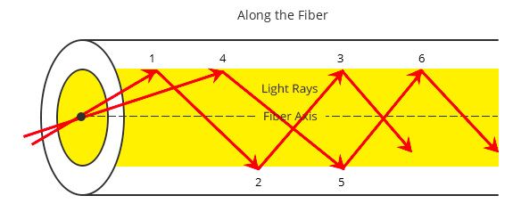
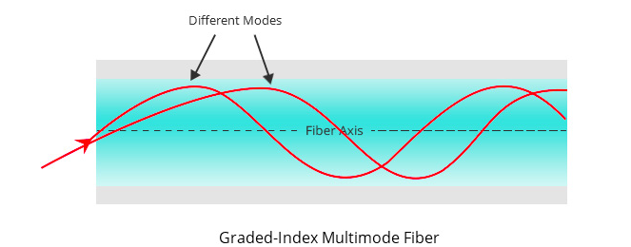
Step Index VS Graded Index

Slide 22
Comparison of Guided Media
Electrical Cables
Optical Cables
Moderate data rates: 1Gb/s
Maximum distance: 2km (twisted pair); 10km (coaxial)
Cheapest for low data rates
UTP: easy to install, susceptible to interference
STP, Coaxial Cable: rigid, protection against interference
Very high data rates: 100Gb/s
Maximum distance: 40km
Expensive equipment, but cost effective for high data rates, Difficult to install

Slide 23
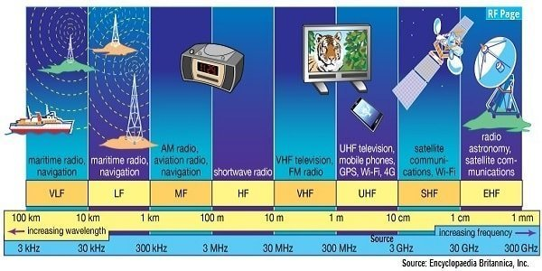
Wireless transmission 3 general range of frequencies
Microwave frequency 1GHz to 40GHz
Highly directional-satellite communication, tower to tower communication
Radio frequency 30MHz to 1 GHz
Infrared frequency 3x10¹¹ to 2x10¹² Hz
Within confined room(TV remote)

Slide 24
Antennas
electrical conductor used to radiate or collect electromagnetic energy
transmission antenna
radio frequency energy from transmitter
converted to electromagnetic energy by antenna
radiated into surrounding environment
reception antenna
converted to radio frequency electrical energy
fed to receiver
same antenna is often used for both purposes
Notes:
For unguided media, transmission and reception are achieved by means of an antenna. An antenna can be defined as an electrical conductor or system of conductors used either for radiating electromagnetic energy or for collecting electromagnetic energy.
For transmission of a signal, radio-frequency electrical energy from the transmitter is converted into electromagnetic energy by the antenna and radiated into the surrounding environment.
For reception of a signal, electromagnetic energy impinging on the antenna is converted into radio-frequency electrical energy and fed into the receiver.
In two-way communication, the same antenna can be and often is used for both transmission and reception. This is possible because antenna characteristics are essentially the same whether an antenna is sending or receiving electromagnetic energy.

Slide 25
Direction and propagation of a wave depends on antenna shape
Isotropic antenna: power propagates in all directions equally (spherical pattern, ideal)
Omni-directional antenna: power propagates in all directions on one plane
Directional antenna: power concentrated in particular direction
Power output in particular direction compared to power produced by isotropic antenna is antenna gain [dB]

Slide 26
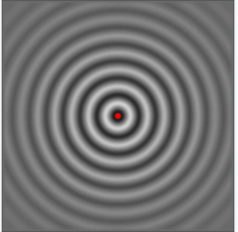
Isotropic antenna
An antenna will radiate power in all directions but, typically, does not perform equally well in all directions.

Slide 27
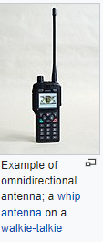
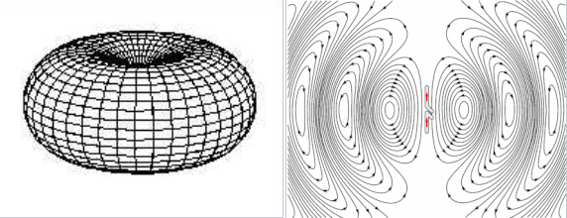
Omni-directional antenna

Slide 28
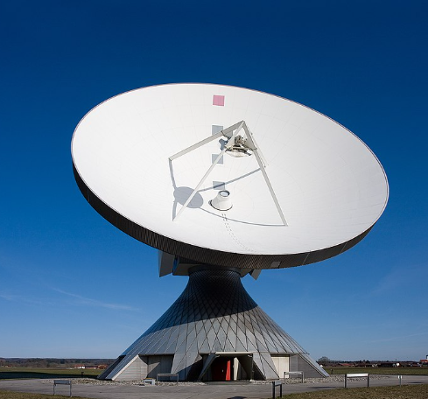
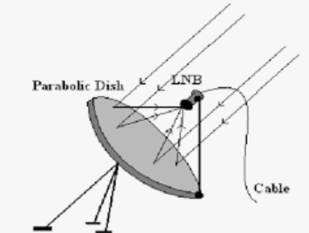
Parabolic Reflective Antenna
Used in terrestrial microwave and satellite applications.

Slide 29
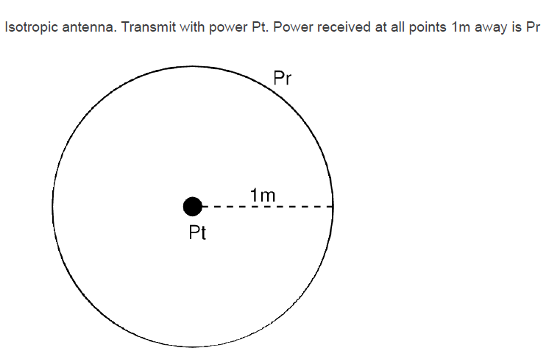
Wireless

Slide 30
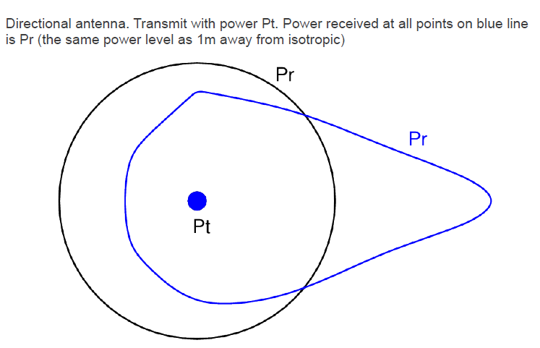

Slide 31
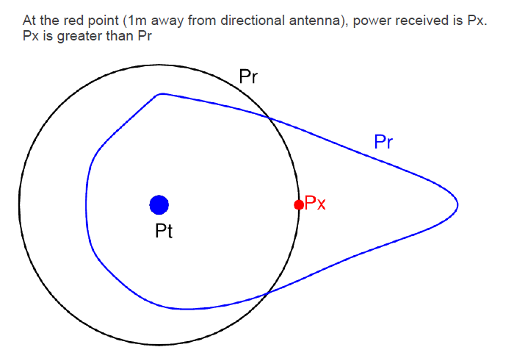

Slide 32
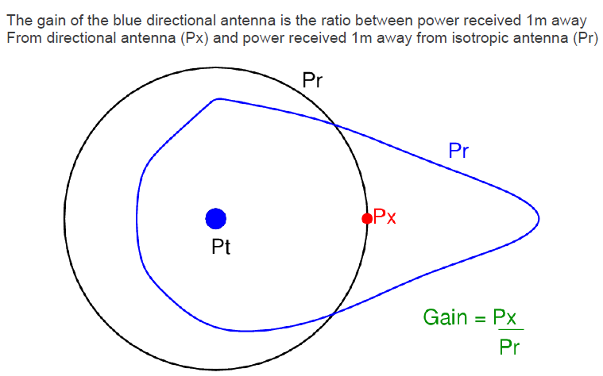

Slide 33
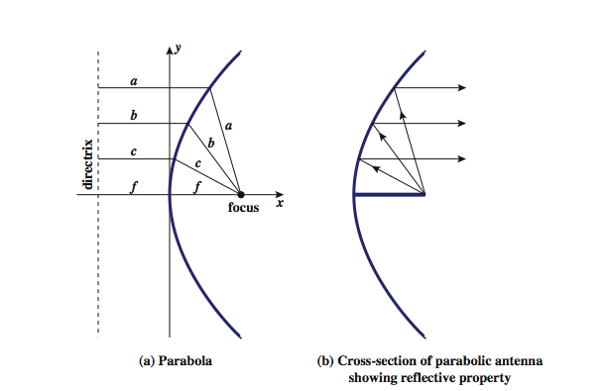

Slide 34
Antenna Gain
measure of directionality of antenna
power output in particular direction verses that produced by an isotropic antenna
measured in decibels (dB)
effective area relates to size and shape
related to gain
Notes:
Antenna gain is a measure of the directionality of an antenna. Antenna gain is defined as the power output, in a particular direction, compared to that produced in any direction by a perfect omnidirectional antenna (isotropic antenna). For example, if an antenna has a gain of 3 dB, that antenna improves upon the isotropic antenna in that direction by 3 dB, or a factor of 2. The increased power radiated in a given direction is at the expense of other directions. In effect, increased power is radiated in one direction by reducing the power radiated in other directions. It is important to note that antenna gain does not refer to obtaining more output power than input power but rather to directionality.
A concept related to that of antenna gain is the effective area of an antenna. The effective area of an antenna is related to the physical size of the antenna and to its shape, as shown in equation 4.1.

Slide 35

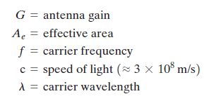
effective area of an antenna
The effective area of an antenna is related to the physical size of the antenna and to its shape.

Slide 36

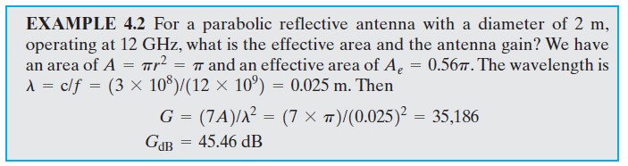
The effective area of an ideal isotropic antenna is with a power gain of 1;
The effective area of a parabolic antenna with a face area of A is 0.56A, with a power gain of

Slide 37

Terrestrial Microwave
Used for long haul telecommunications and short point-to-point links
Requires fewer repeaters but must be LOS
Use a parabolic dish to focus a narrow beam onto a receiver antenna
1-40GHz frequencies
Higher frequencies give higher data rates
main source of loss is attenuation + interference
Notes:
The primary use for terrestrial microwave systems is in long haul telecommunications service, as an alternative to coaxial cable or optical fiber. The microwave facility requires far fewer amplifiers or repeaters than coaxial cable over the same distance, (typically every 10-100 km) but requires line-of-sight transmission. Microwave is commonly used for both voice and television transmission. Another increasingly common use of microwave is for short point-to-point links between buildings, for closed-circuit TV or as a data link between local area networks.
The most common type of microwave antenna is the parabolic "dish”, fixed rigidly to focus a narrow beam on a receiving antenna A typical size is about 3 m in diameter. Microwave antennas are usually located at substantial heights above ground level to extend the range between antennas and to be able to transmit over intervening obstacles. To achieve long-distance transmission, a series of microwave relay towers is used, and point-to-point microwave links are strung together over the desired distance.
Microwave transmission covers a substantial portion of the electromagnetic spectrum, typically in the range 1 to 40 GHz, with 4-6GHz and now 11GHz bands the most common. The higher the frequency used, the higher the potential bandwidth and therefore the higher the potential data rate. As with any transmission system, a main source of loss is attenuation, related to the square of distance. The effects of rainfall become especially noticeable above 10 GHz. Another source of impairment is interference.

Slide 38

As with any transmission system, a main source of loss is attenuation. For microwave (and radio frequencies), the loss can be expressed as
where d is the distance and λ is the wavelength, in the same units

Slide 39
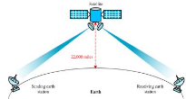
Satellite Microwave
satellite is relay station:
earth /ground stations → satellite → earth /ground stations
receives on one frequency band (uplink),), amplifies or repeats signal and transmits on another frequency (downlink)
eg. uplink 5.925-6.425 GHz & downlink 3.7-4.2 GHz
transponder channels(transponders): The subsystem, which provides the connecting link between transmitting and receiving antennas of a satellite.
used for communications, navigation, map-making, astronomical observations, scientific experimentation, and monitoring of the Earth's environment
typically requires geo-stationary orbit
height of 35,784km
spaced at least 3-4° apart
typical uses
television
long distance telephone
private business networks
global positioning
Notes:
A communication satellite is, in effect, a microwave relay station. It is used to link two or more ground-based microwave transmitter/receivers, known as earth stations, or ground stations. The satellite receives transmissions on one frequency band (uplink), amplifies or repeats the signal, and transmits it on another frequency (downlink). A single orbiting satellite will operate on a number of frequency bands, called transponder channels, or simply transponders. The optimum frequency range for satellite transmission is in the range 1 to 10 GHz. Most satellites providing point-to-point service today use a frequency bandwidth in the range 5.925 to 6.425 GHz for transmission from earth to satellite (uplink) and a bandwidth in the range 3.7 to 4.2 GHz for transmission from satellite to earth (downlink). This combination is referred to as the 4/6-GHz band, but has become saturated. So the 12/14-GHz band has been developed (uplink: 14 - 14.5 GHz; downlink: 11.7 - 12.2 GHz).
For a communication satellite to function effectively, it is generally required that it remain stationary with respect to its position over the earth to be within the line of sight of its earth stations at all times. To remain stationary, the satellite must have a period of rotation equal to the earth's period of rotation, which occurs at a height of 35,863 km at the equator. Two satellites using the same frequency band, if close enough together, will interfere with each other. To avoid this, current standards require a 4° spacing in the 4/6-GHz band and a 3° spacing at 12/14 GHz. Thus the number of possible satellites is quite limited.
Among the most important applications for satellites are: Television distribution, Long-distance telephone transmission, Private business networks, and Global positioning.

Slide 40
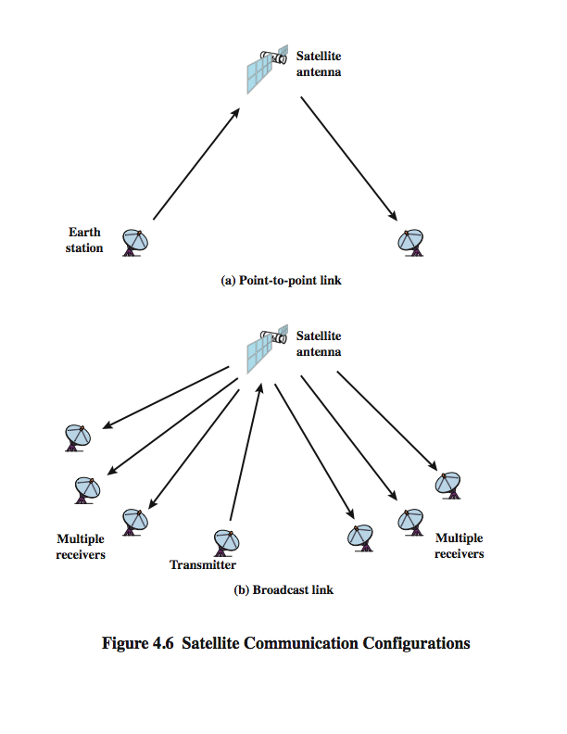
Satellite Point to Point Link
Notes:
Stallings DCC8e Figure 4.6 depicts in a general way two common configurations for satellite communication. In the first, the satellite is being used to provide a point-to-point link between two distant ground-based antennas.

Slide 41
Satellite Broadcast Link
Notes:
Stallings DCC8e Figure 4.6 depicts in a general way two common configurations for satellite communication. In the second, the satellite provides communications between one ground-based transmitter and a number of ground-based receivers.

Slide 42
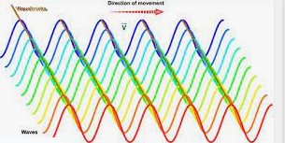
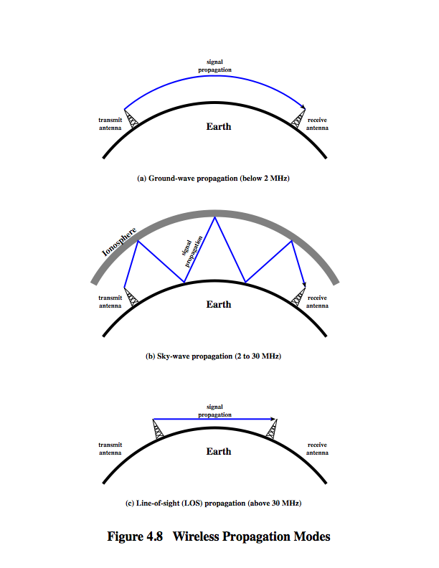
Wireless Propagation Ground Wave
electromagnetic wave induces a current in the earth’s surface, the result of which is to slow the wavefront near the earth, causing the wavefront to tilt downward and hence follow the earth’s curvature
scattered by the atmosphere in such a way that they do not penetrate the upper atmosphere(diffraction)
Notes:
A signal radiated from an antenna travels along one of three routes: ground wave, sky wave, or line of sight (LOS), as shown in Stallings DCC8e Figure 4.8.
Ground wave propagation more or less follows the contour of the earth and can propagate considerable distances, well over the visual horizon. This effect is found in frequencies up to about 2 MHz. Several factors account for the tendency of electromagnetic wave in this frequency band to follow the earth's curvature. One factor is that the electromagnetic wave induces a current in the earth's surface, the result of which is to slow the wavefront near the earth, causing the wavefront to tilt downward and hence follow the earth's curvature. Another factor is diffraction, which is a phenomenon having to do with the behavior of electromagnetic waves in the presence of obstacles. Electromagnetic waves in this frequency range are scattered by the atmosphere in such a way that they do not penetrate the upper atmosphere. The best-known example of ground wave communication is AM radio.

Slide 43
Wireless Propagation Sky Wave
Notes:
Sky wave propagation is used for amateur radio, CB radio, and international broadcasts such as BBC and Voice of America. With sky wave propagation, a signal from an earth-based antenna is reflected from the ionized layer of the upper atmosphere (ionosphere) back down to earth. Although it appears the wave is reflected from the ionosphere as if the ionosphere were a hard reflecting surface, the effect is in fact caused by refraction. Refraction is described subsequently. A sky wave signal can travel through a number of hops, bouncing back and forth between the ionosphere and the earth's surface, as shown in Stallings DCC8e Figure 4.8b. With this propagation mode, a signal can be picked up thousands of kilometers from the transmitter.

Slide 44
Wireless Propagation Line of Sight
Notes:
Above 30 MHz, neither ground wave nor sky wave propagation modes operate, and communication must be by line of sight (Stallings DCC8e Figure 4.8c). For satellite communication, a signal above 30 MHz is not reflected by the ionosphere and therefore a signal can be transmitted between an earth station and a satellite overhead that is not beyond the horizon. For ground-based communication, the transmitting and receiving antennas must be within an effective line of sight of each other. The term effective is used because microwaves are bent or refracted by the atmosphere. The amount and even the direction of the bend depends on conditions, but generally microwaves are bent with the curvature of the earth and will therefore propagate farther than the optical line of sight. In this book, we are almost exclusively concerned with LOS communications.

